Slide 1
Project Portfolio
Jordan Clark

Slide 2
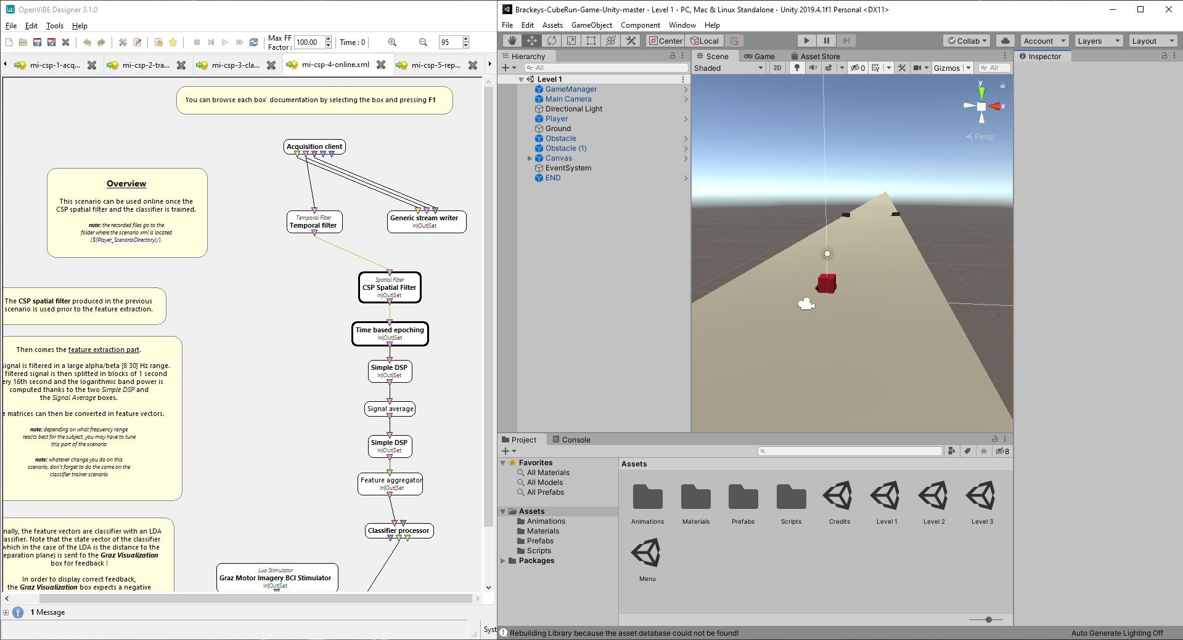
Cube runner 2-class MI (motor Imagery) game
Canadarm ISS VR
Compare power spectral density in alpha and beta frequency domain of EEG signals over motor cortex when controlling Canadarm VR model with joystick under various alternate gravity environments simulated using an unloading harness and an inversion table
Train using OpenViBE’s MI demo
Offline LDA to train classifier
Run realtime scenario
LSL to send classifier result to Unity
Move cube left or right to avoid blocks

Slide 3
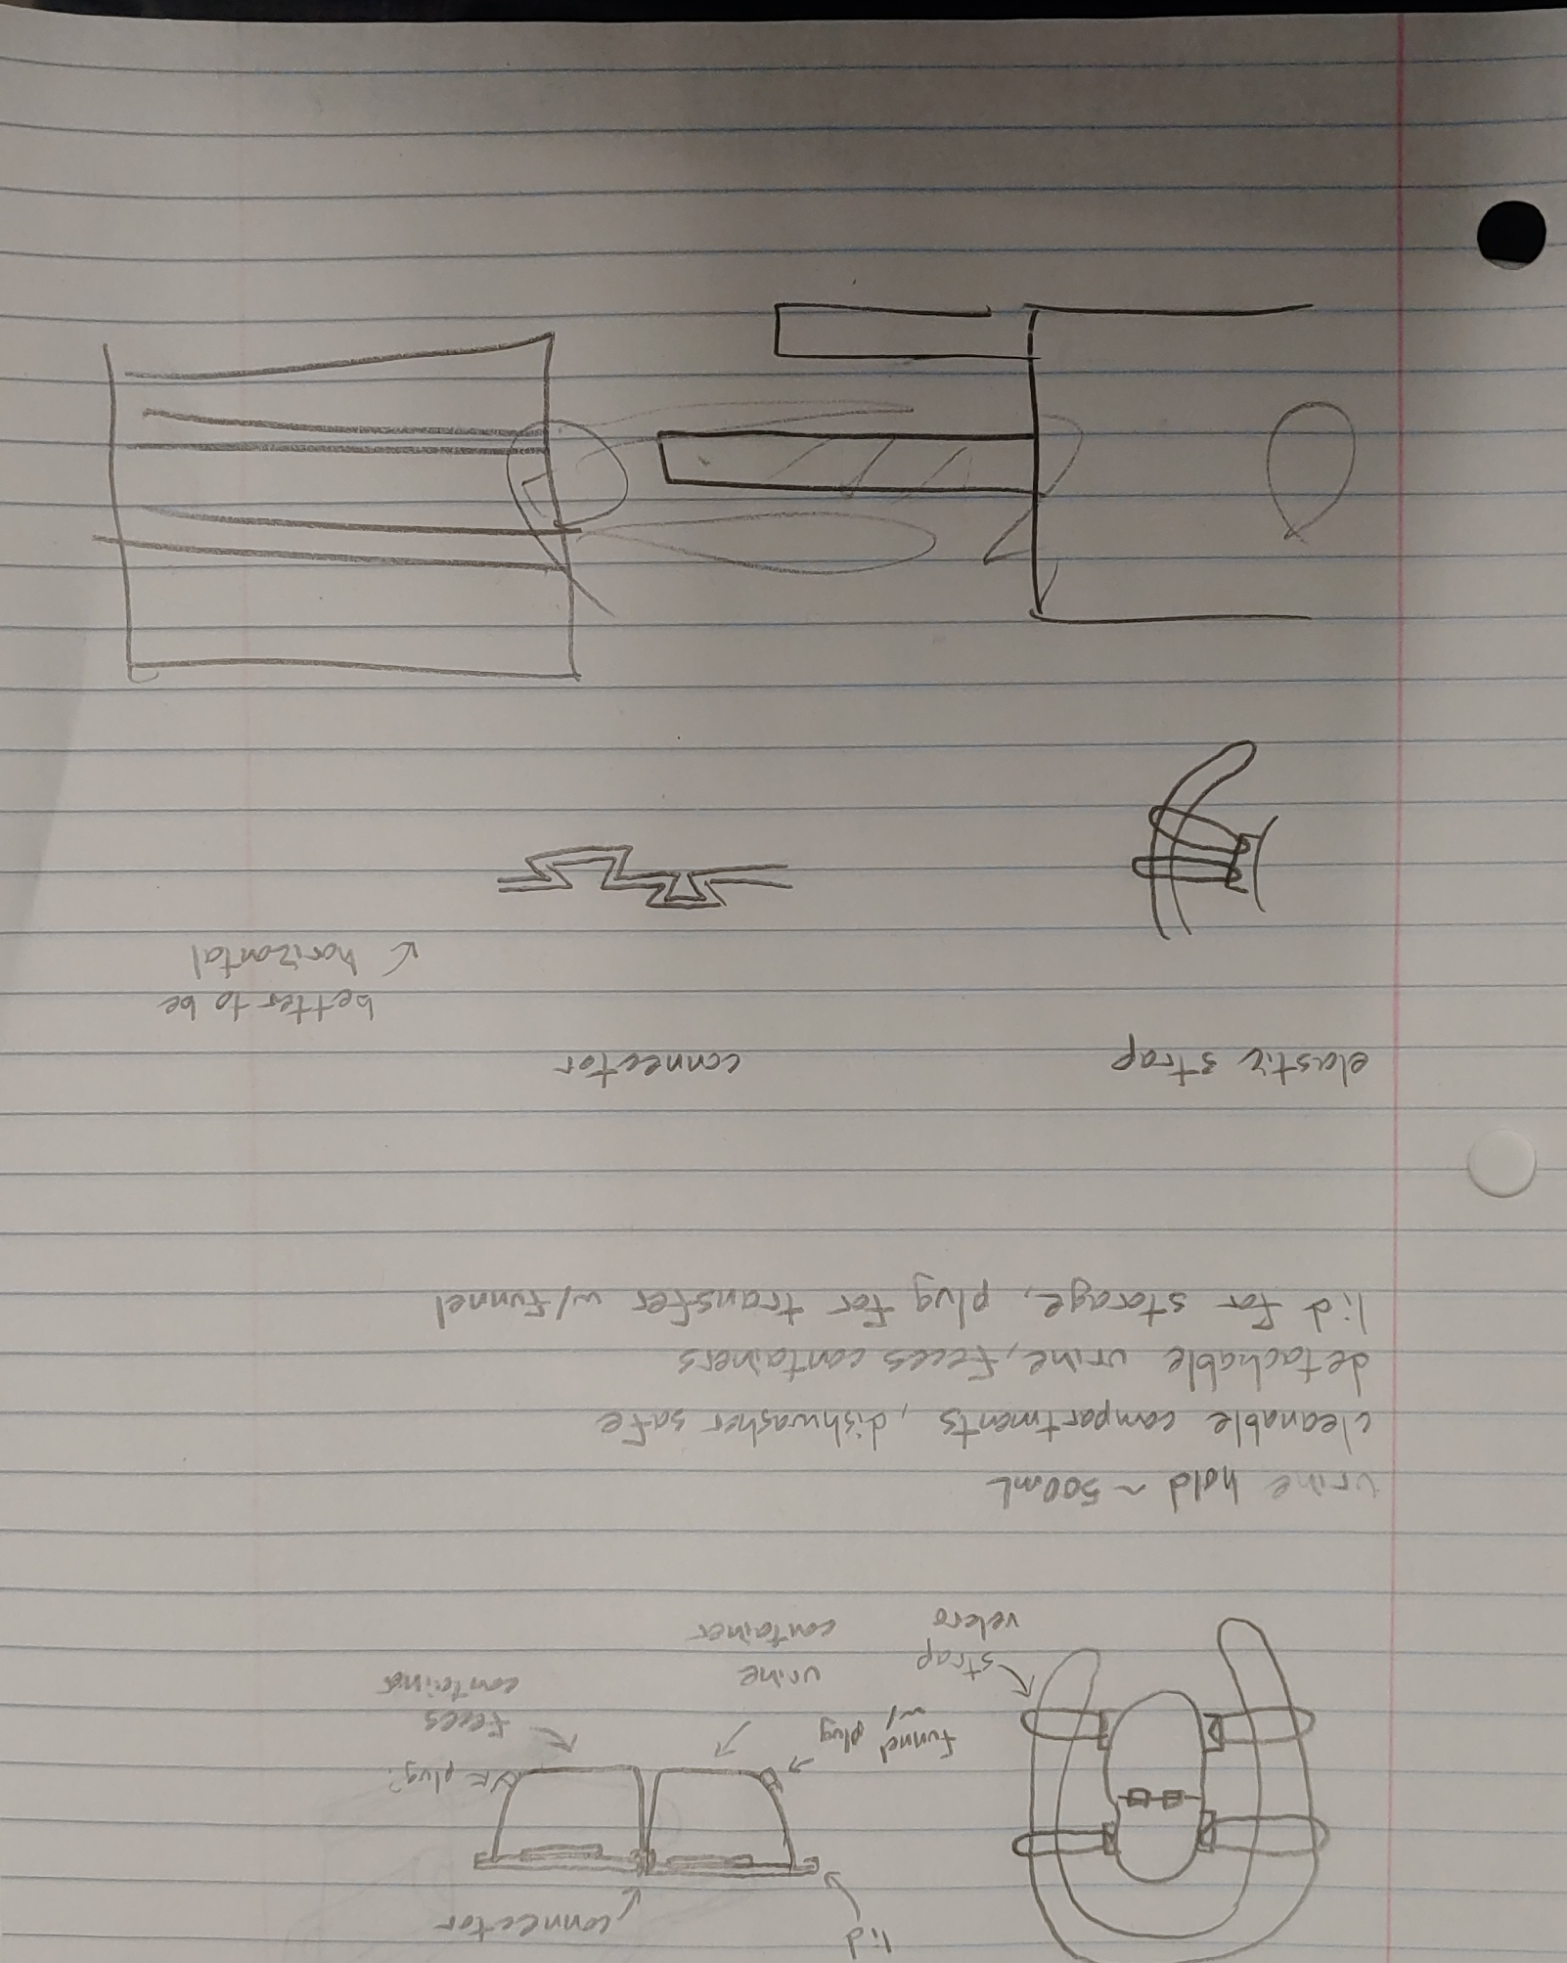
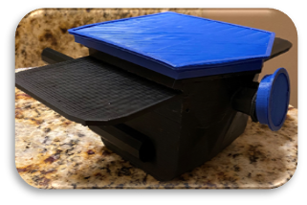
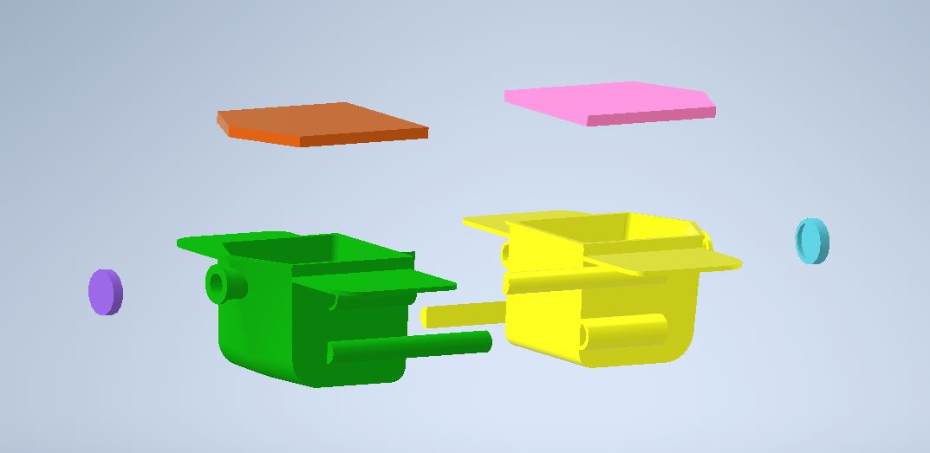
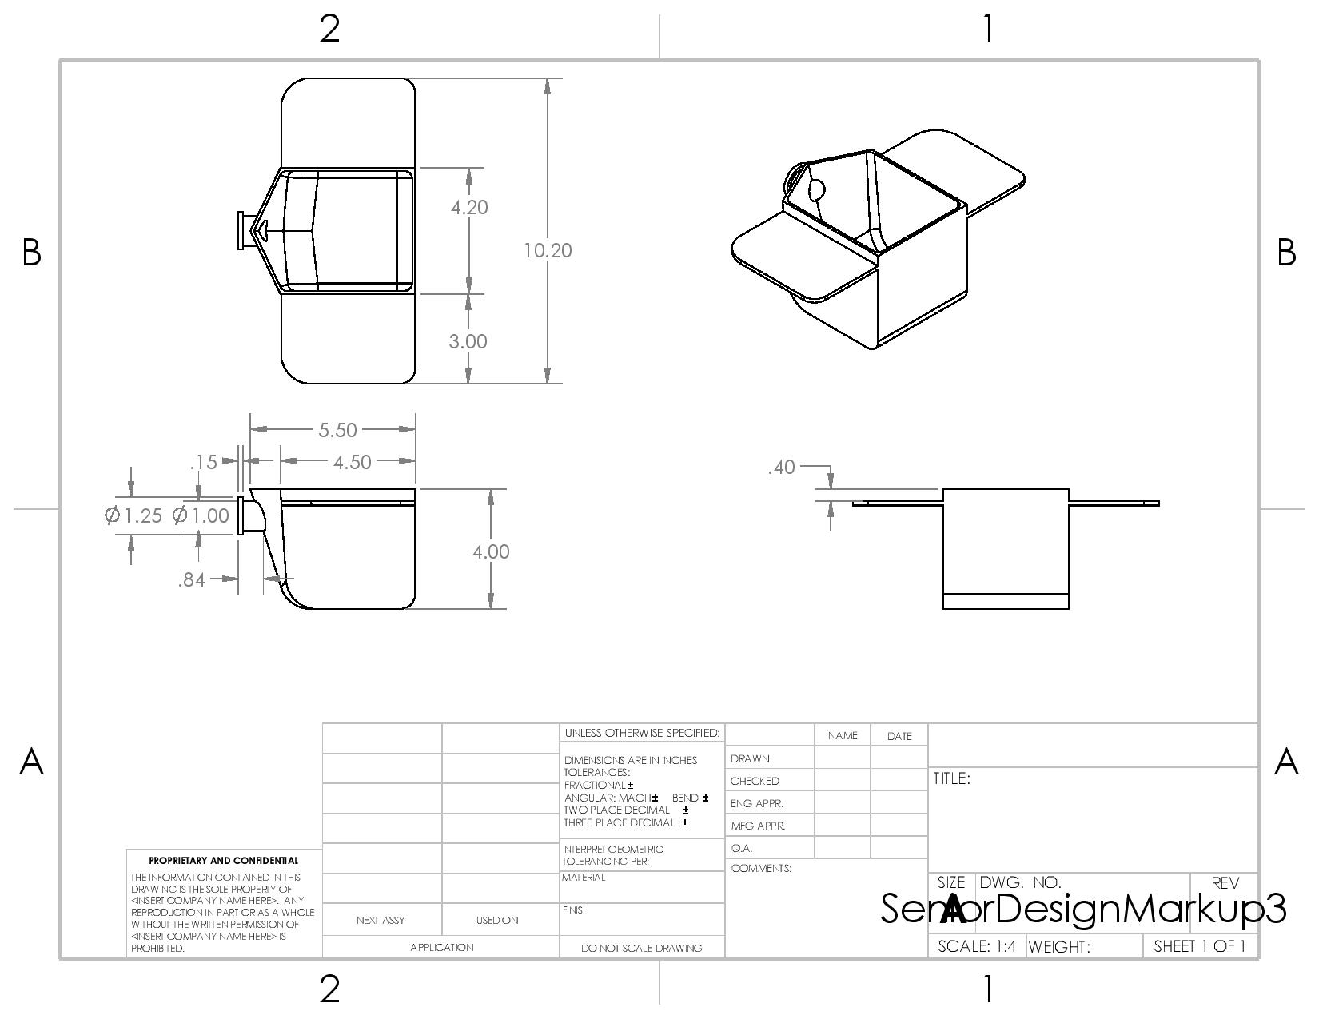
Excrement collection device : Senior Design
Separate liquids and solids
Store in collection device
Sanitary transfer to larger container
Sanitary transport to lab for analysis
My part: design ideation, CAD, animation, 3D printing

Slide 4
SSVEP control for VR drone flight : BCI Class Final Project
Unity training and testing environment
UDP to sync unity with EEG to label directions
Offline analysis for method verification
Realtime Simulink model using persistent matrix
Fast Fourier Transform to covert to frequency domain
Prediction is frequency at highest intensity
Moving mean of predicted frequencies
Choose least difference to target frequencies
Send prediction and receive in unity via UDP
Move drone in predicted direction

Slide 5
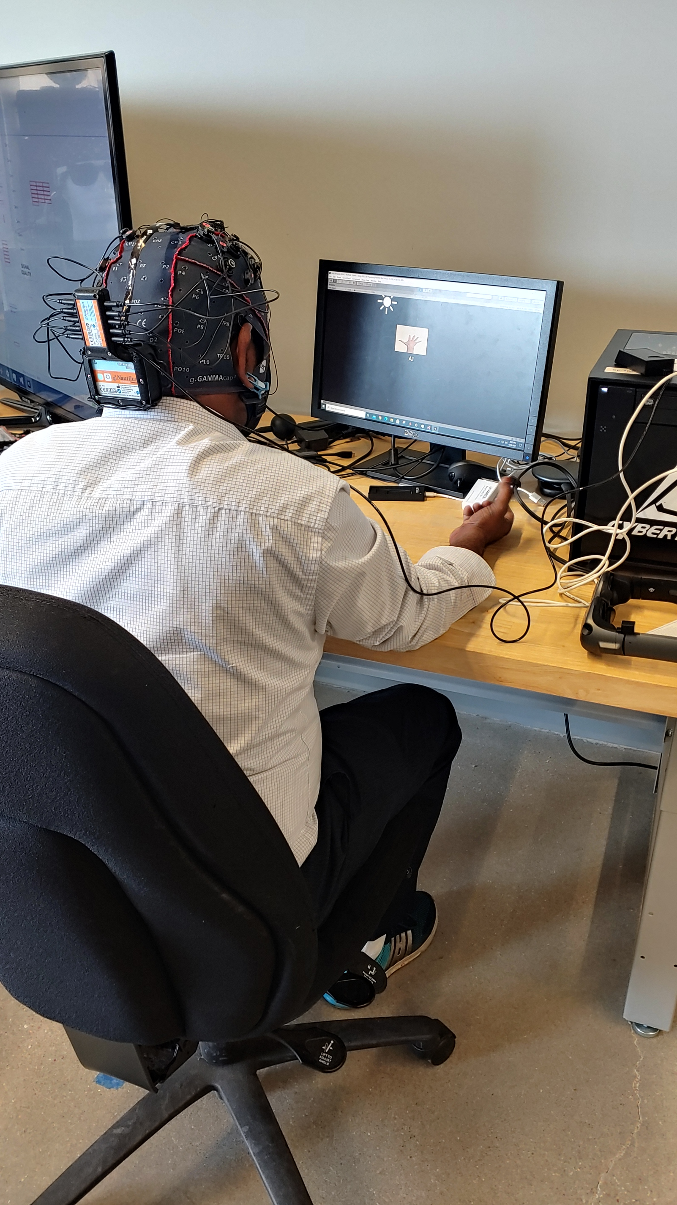
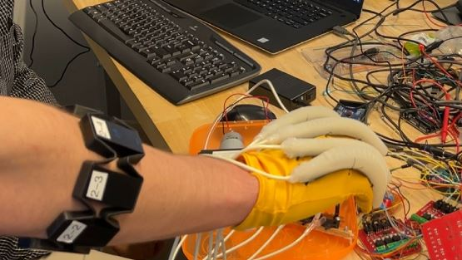
Hybrid BCI soft-robotic assistive glove : Biorobotics Class Final project
Unity training environment w/ udp to Simulink
7-class actual movement with EEG + fNIRS over motor cortex
Thumb, index, middle, ring, pinky, fist, relaxed
13-class with EMG - soft and strong finger movements
Matlab for offline and online feature extraction
EEG – power spectral density, spectral flatness, entropy
fNIRS – avg, rms, skewness, kurtosis
Train NN using features and target matrices
Realtime simulink model using trained NN
UDP send predicted finger to glove’s Arduino code
Adjust air pressure to actuate desired finger

Slide 6
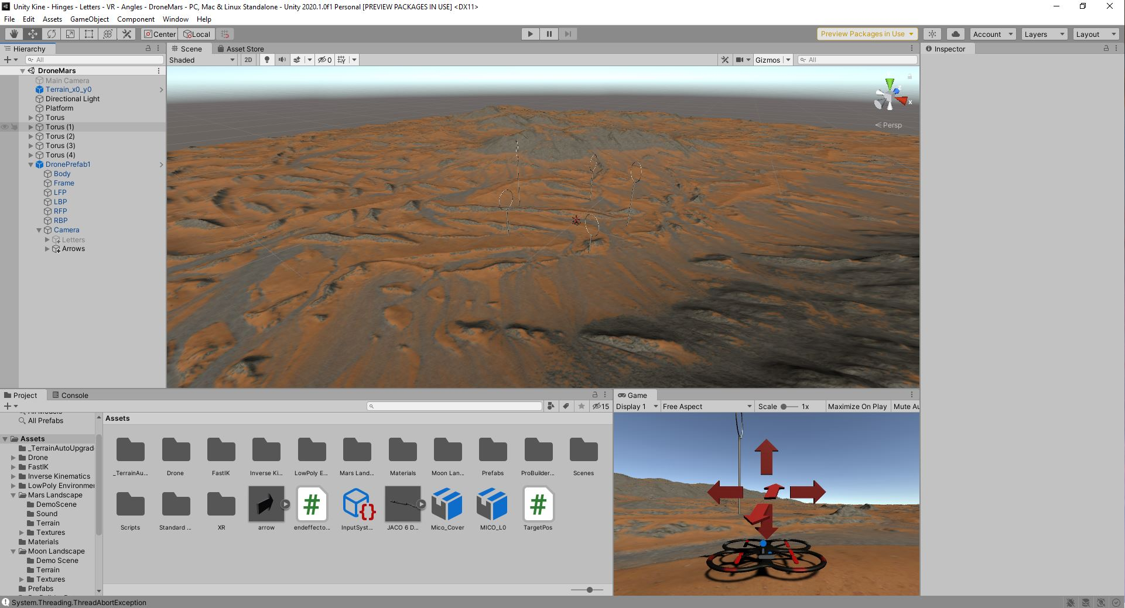
IEEE Student Poster Competition : 2nd place area, 1st place local
Neuro-Virtual Interface System to Understand Human Brain Responses in Simulated Space Conditions
Unloading harness and inversion table to simulate reduced gravity environments
6-class MI and SSVEP to control drone and 7 dof industrial robotic arm
Filter alpha and beta frequency domain
Compare psd and spectral entropy of mars gravity, ISS, and earth
Findings: Spectral beta values increase compared to alpha values for mars and ISS compared to earth, which shows a higher required workload for mental tasks in simulated reduced gravity environments
Kinova Moon SSVEP Environment
Drone Mars MI Environment

Slide 7
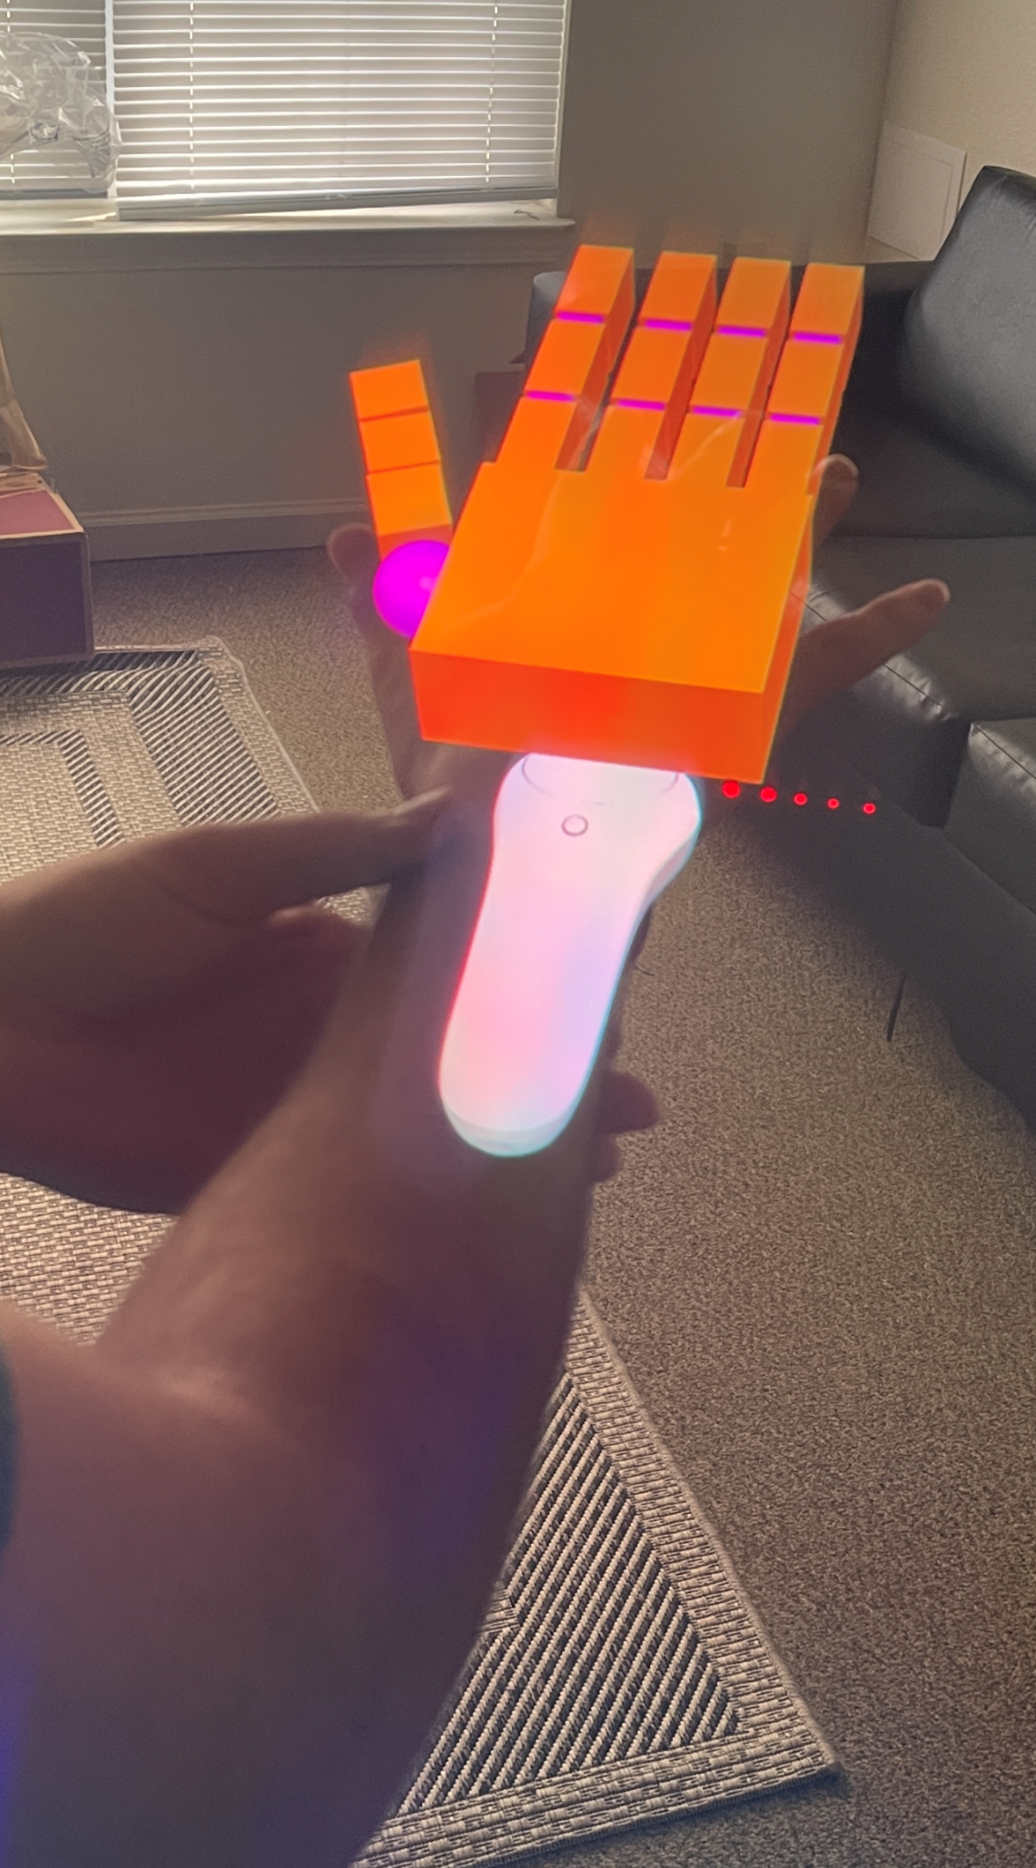
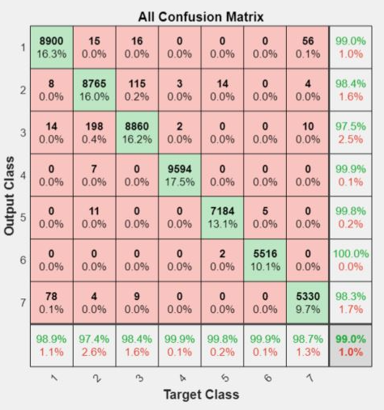
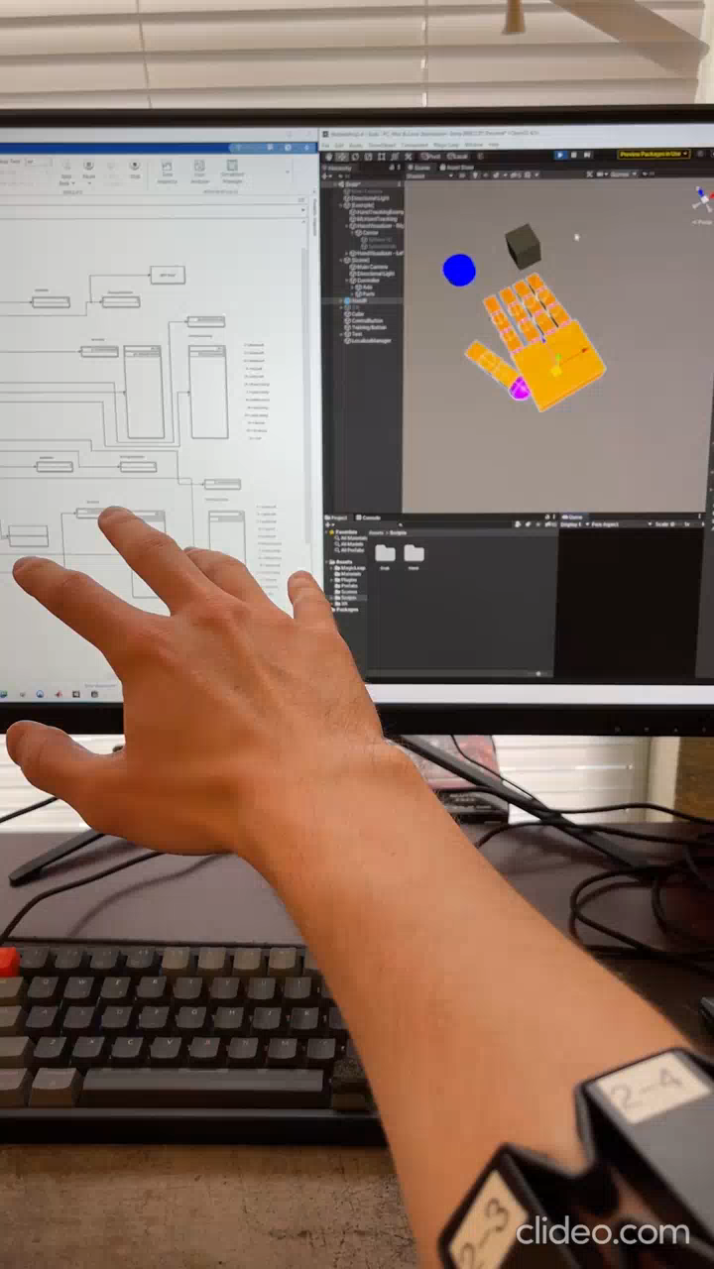
AR EMG Controlled Hand: Master’s Thesis
Unity training environment w/ udp to Simulink
7-class finger movement with myoband
Thumb, index, middle, ring, pinky, fist, relaxed
Sliding window, 15-45Hz bandpass filter, FFT, rectify, normalize
Matlab for real-time feature extraction
Time domain – mean, max, rms, variance, standard deviation, sum
Frequency domain – mean, max, rms, variance, standard deviation, sum
Train NN using features and target matrices
Realtime simulink model using trained NN with real-time accuracy
UDP send predicted finger to Magic Leap One AR Hand
Adjust AR hand joint angles based on predicted class

Slide 8
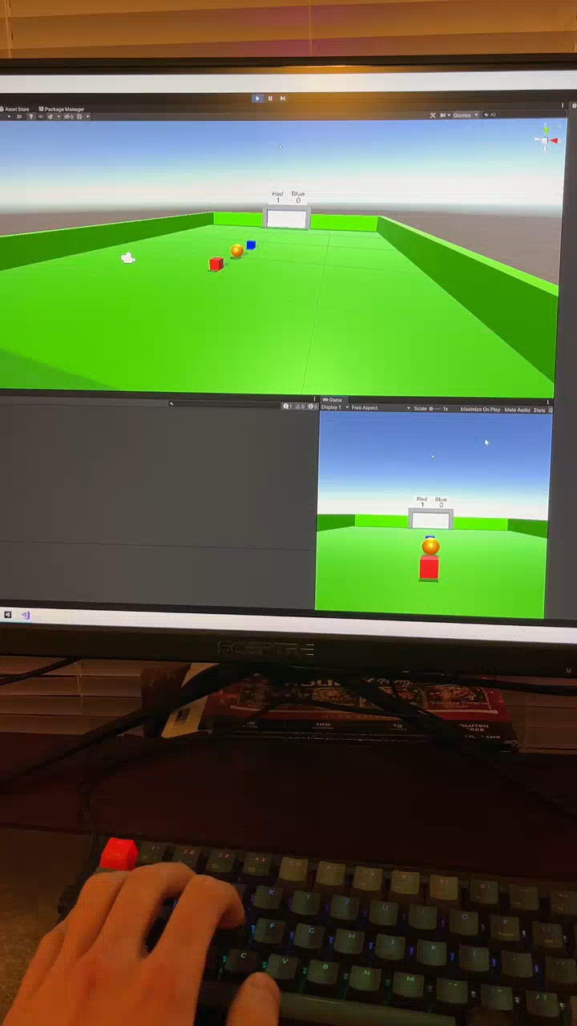
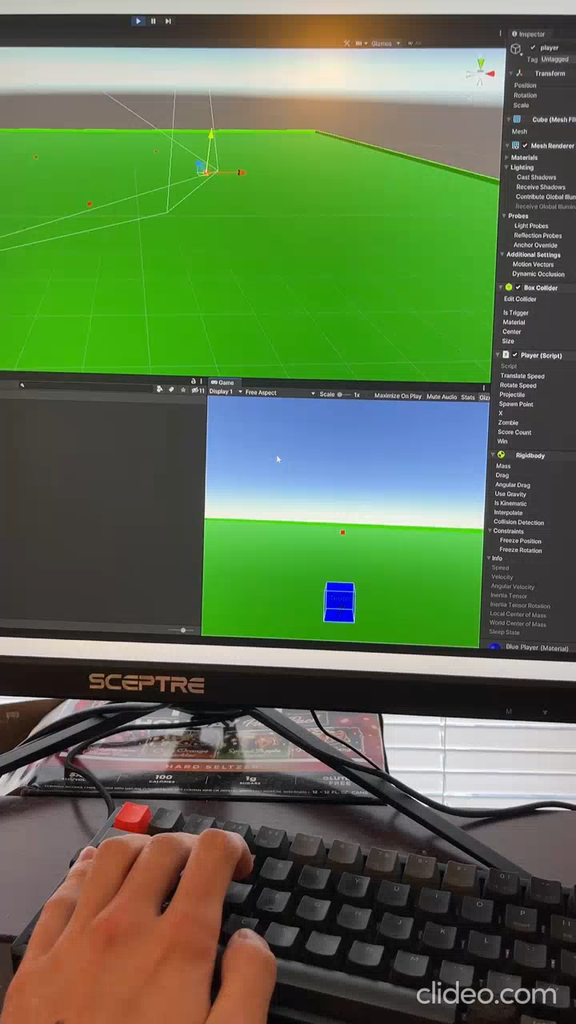
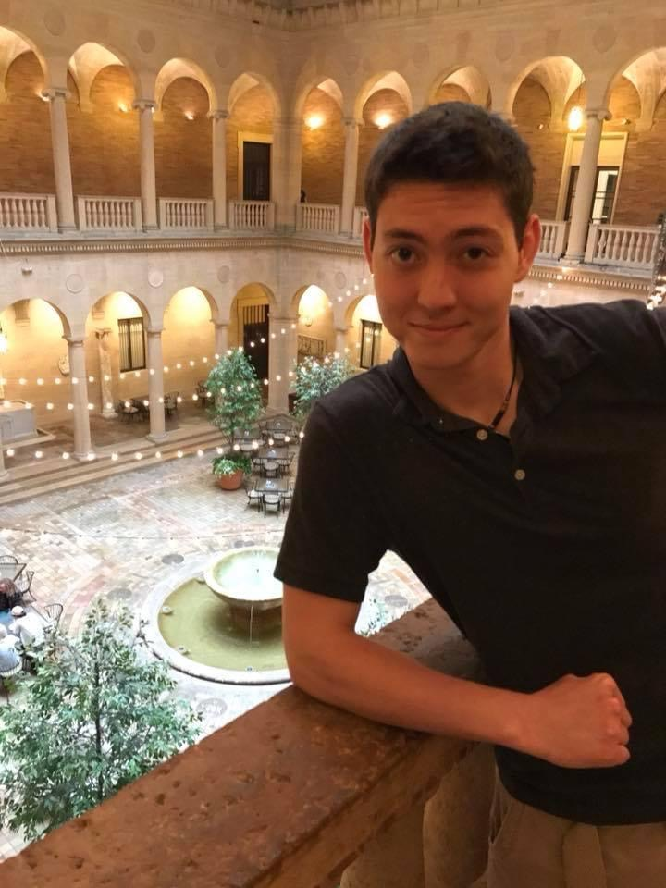
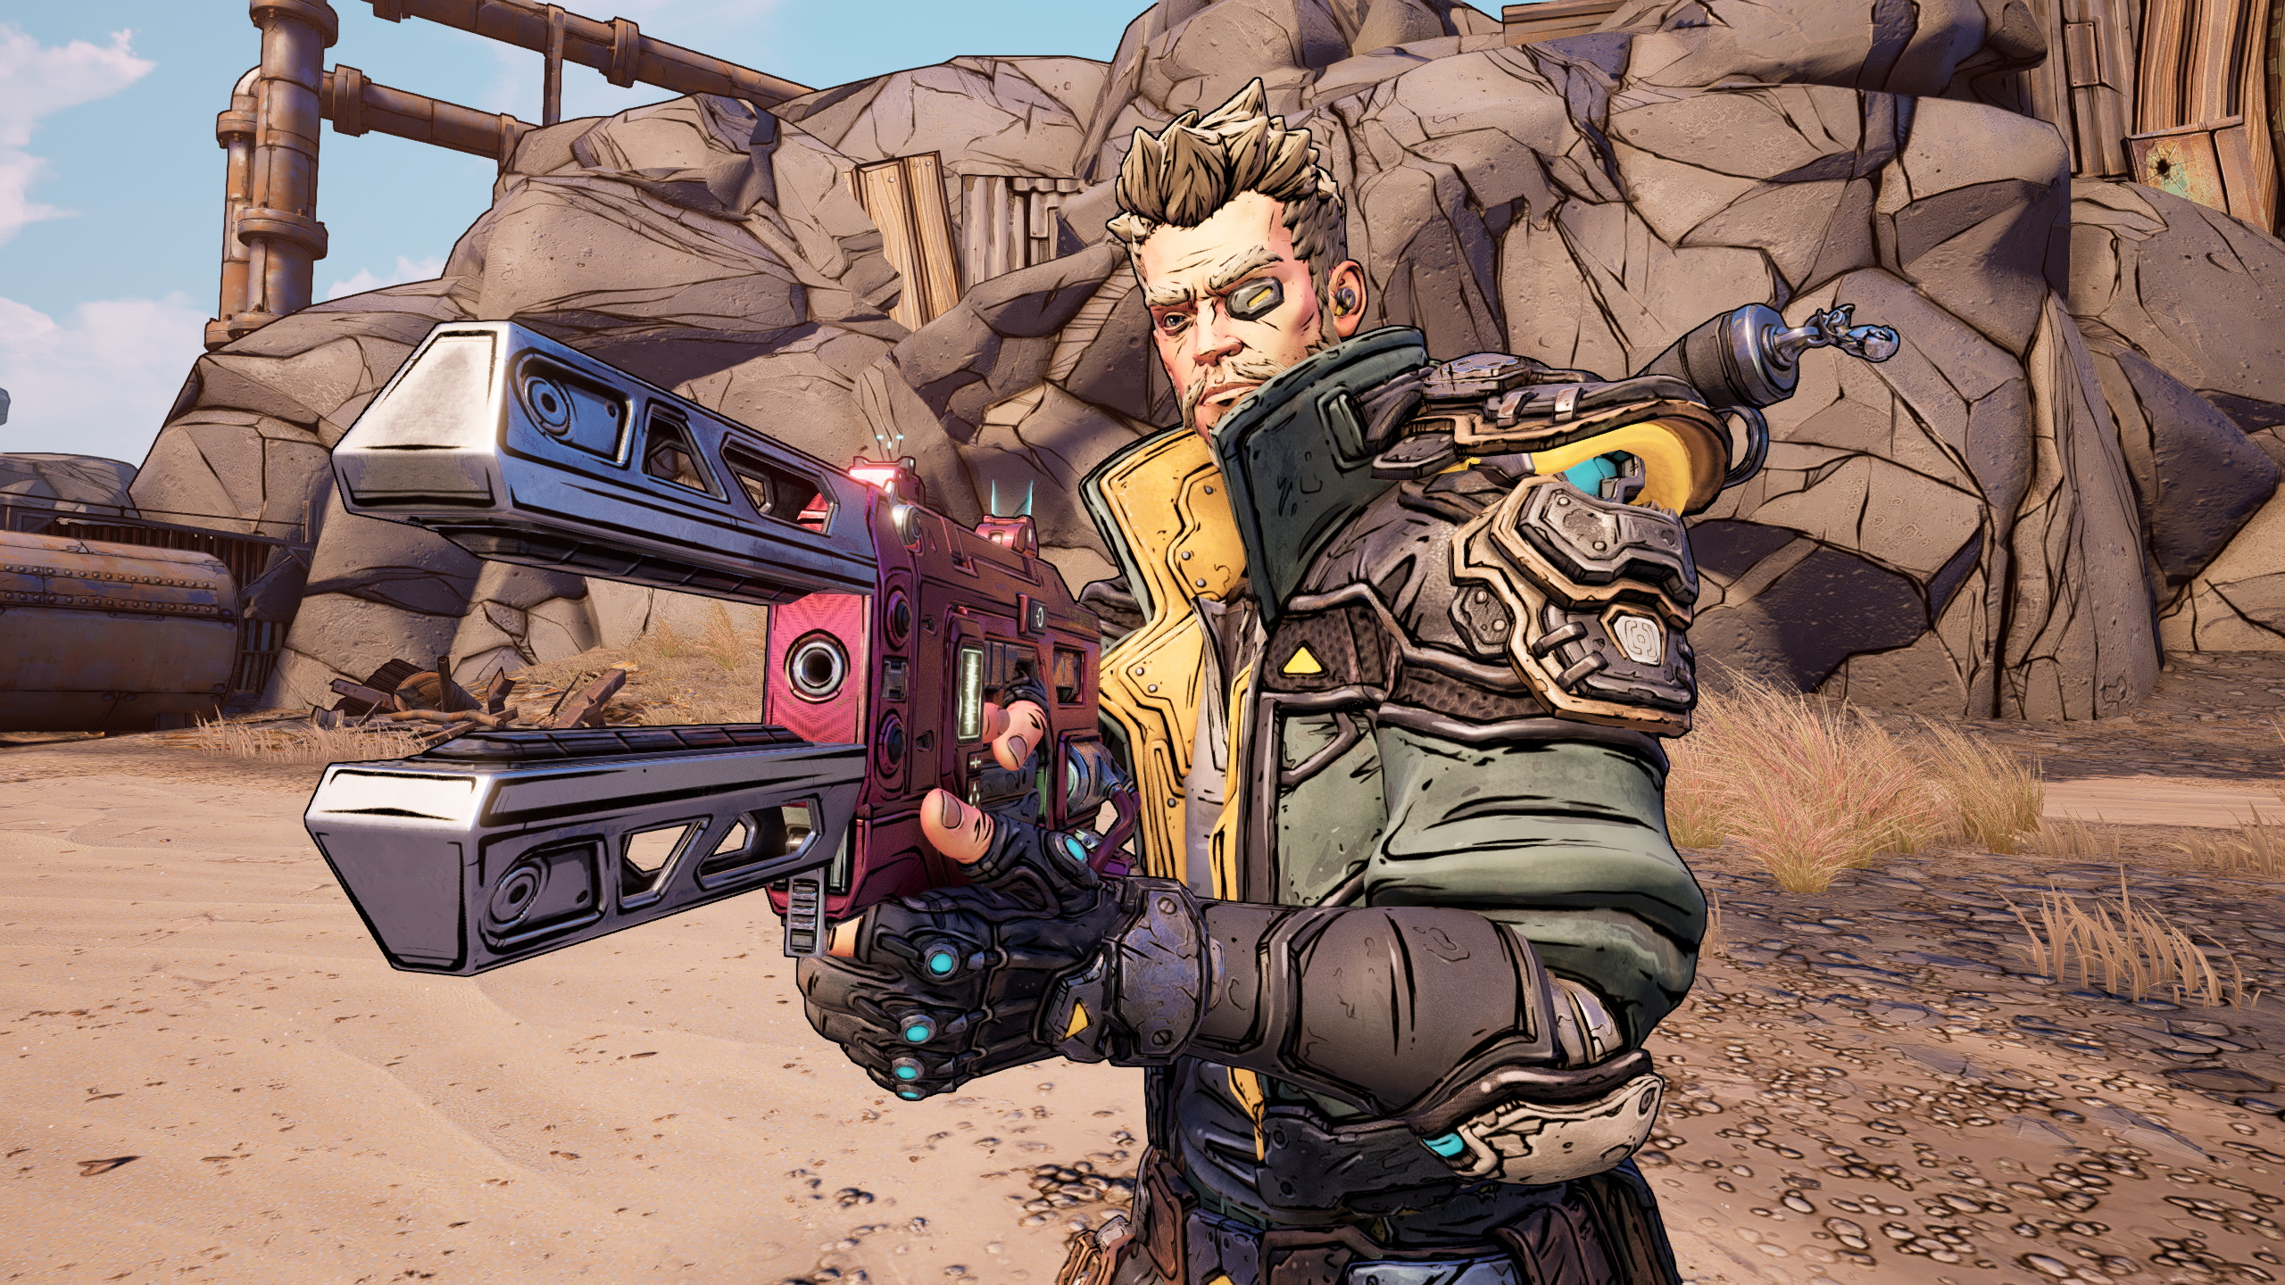
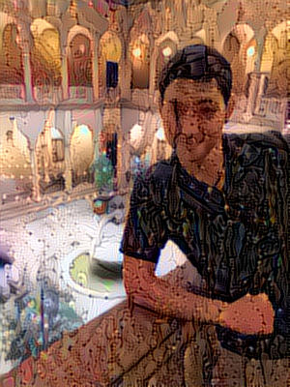

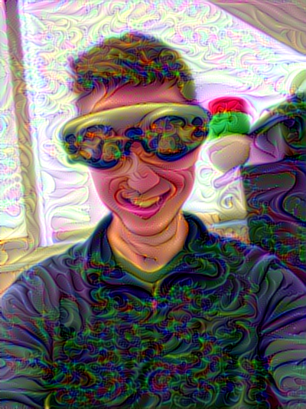
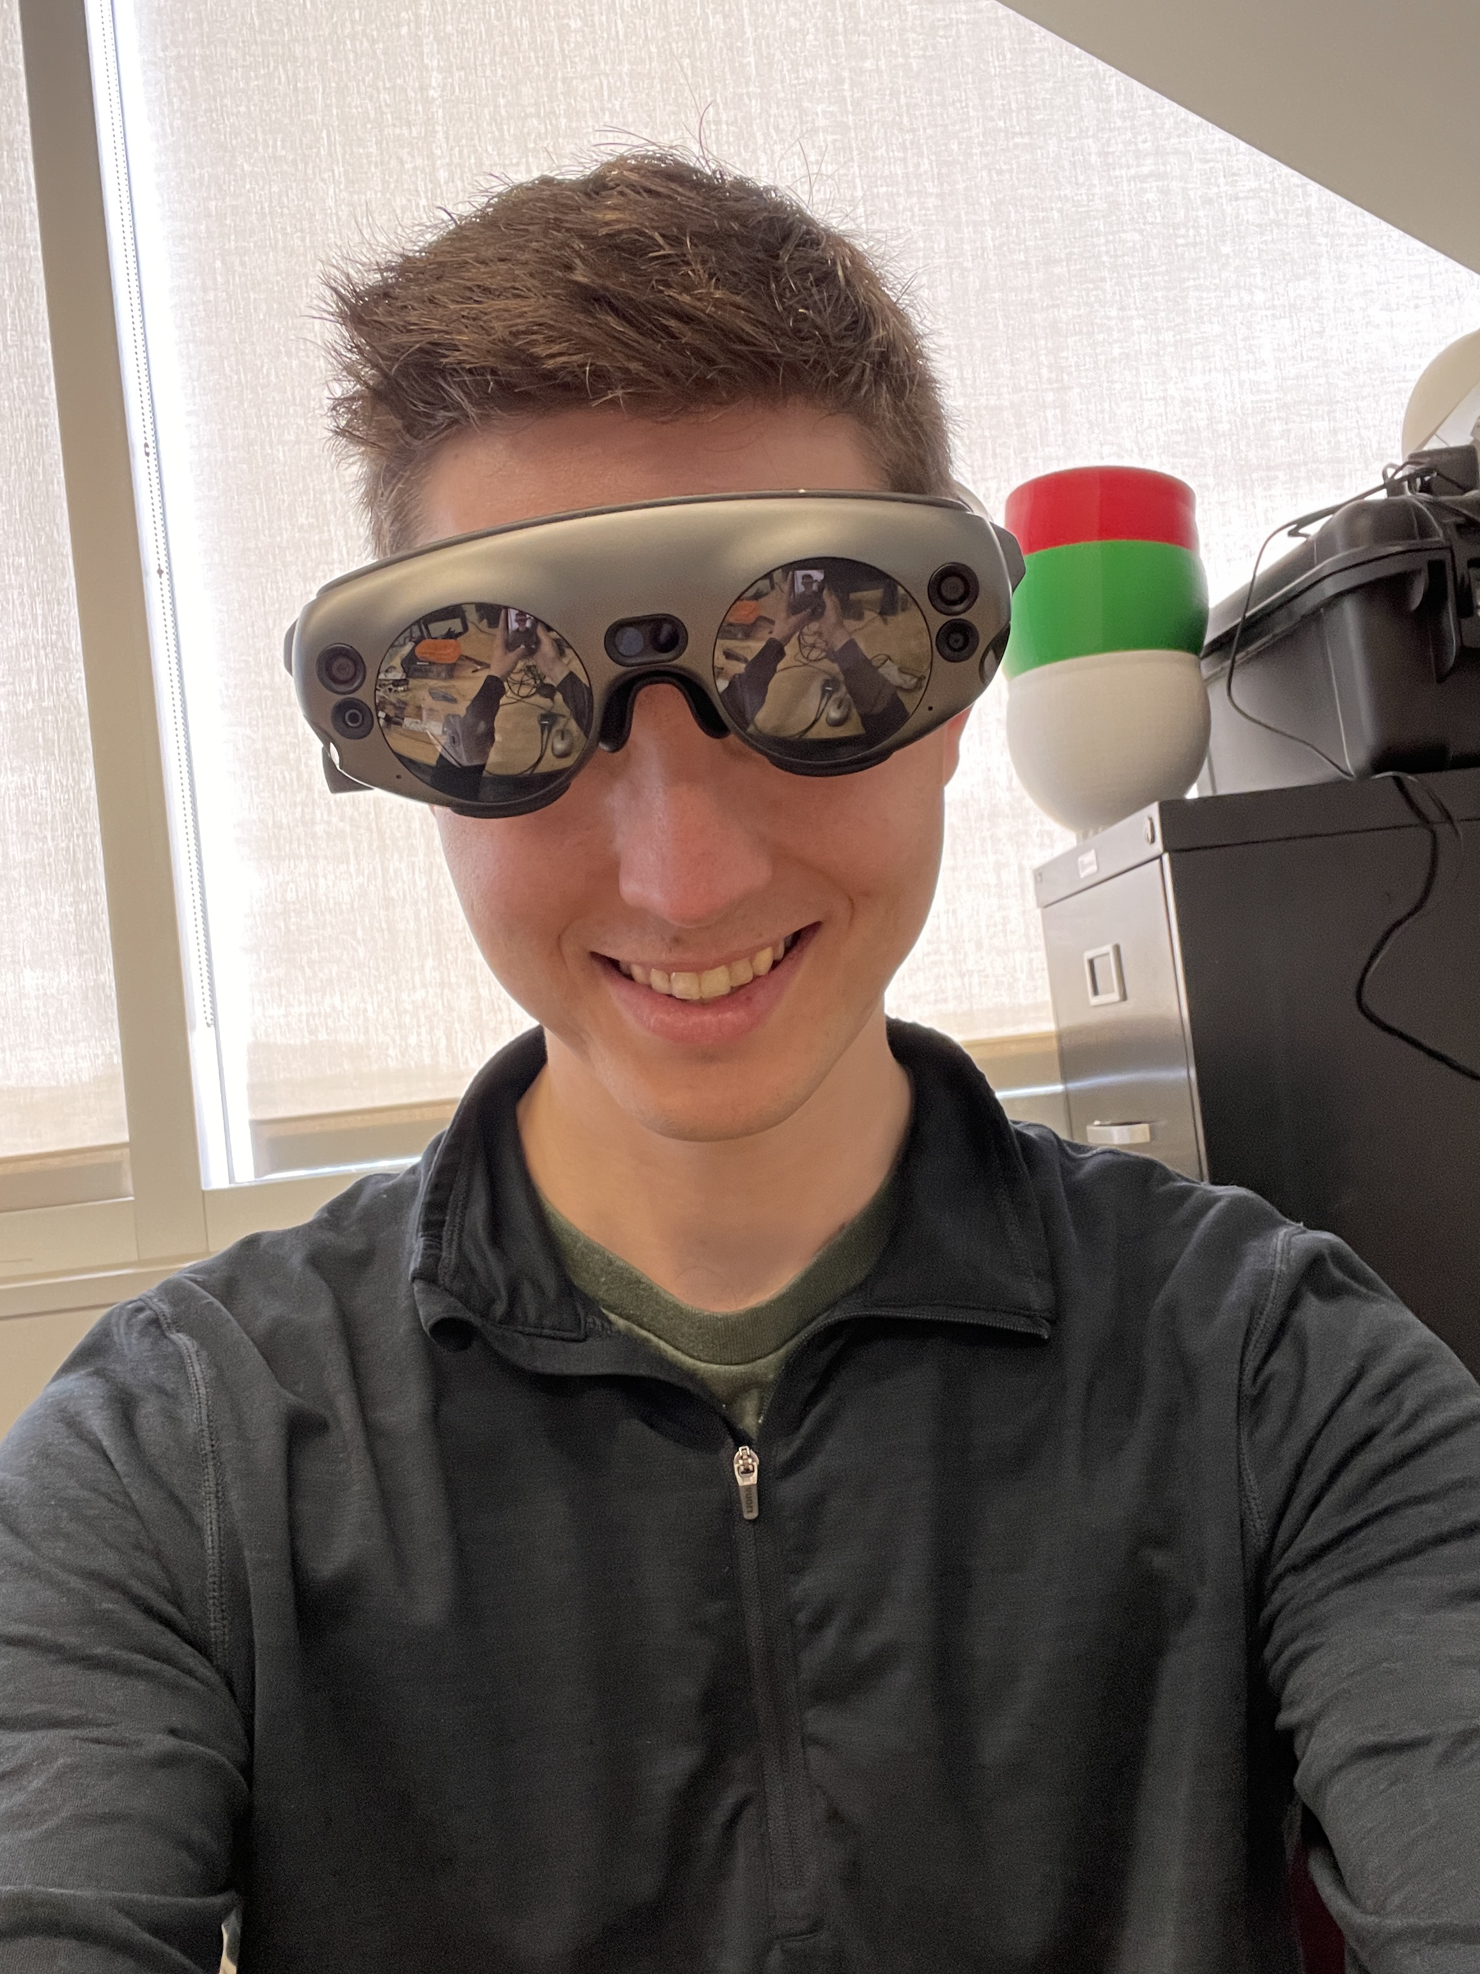
Unity games
Machine Learning
Soccer
Zombie Shooter
Regression classification with Sk-learn
Sentiment Analysis using tensorflow biLSTM & biGRU
Image classification
Sk-learn MLP, Tensforflow sequential nn, biLSTM, GRU
EMG classification
Sk-learn MLP, SVM, Tensorflow sequential nn, biLSTM
CNN Image Style Transfer

Slide 9
Future Interests
BCI | BCI XR | AR | VR
Retinal and cochlear implants DBS therapy EMG remote / keyboard for media and UI controls Adjust game weather, music, dialog based on user’s emotions / vitals Monitor attention during reading, nlp summarize missed material | BCI environment for locked-in patients with MI movement, P300 text editor, MI drawing, SSVEP GUI, telepresence Exposure therapy environment and monitoring for anxiety / phobias to identify and counteract triggers | Surgeon HuD with CV aid Music stand w/ library, tuner, metronome Cooking instructions with CV next step detection and food monitoring Creative workstation 3rd person character controller / rc car Tower defense game | OR w/ HuD for training surgeons Psychology experiment environment Chemistry / Physics lab
 |  |  | Code / ML
 |  |  | Anomaly detection CV for medical diagnoses ConvNets for segmentation, classification GANs for artistic effects RNN, LSTM for dynamic gesture classification

